Slide 1
SRI RAMAKRISHNA ENGINEERING COLLEGE
[Educational Service : SNR Sons Charitable Trust]
[Autonomous Institution, Reaccredited by NAAC with ‘A+’ Grade]
[Approved by AICTE and Permanently Affiliated to Anna University, Chennai]
[ISO 9001-2015 Certified and all eligible programmes Accredited by NBA]
VATTAMALAIPALAYAM, N.G.G.O. COLONY POST, COIMBATORE – 641 022.
Department of Electronics and Communication Engineering
16EC258-MINIPROJECT II
No. of Credits : 2

Slide 2
SRI RAMAKRISHNA ENGINEERING COLLEGE
Class / Section / Semester | : | ECE / C / v
Batch | : | 17
Project Review | : | THIRD REVIEW
Title of the project | : | LUNG CANCER PREDICTION USING DEEP LEARNING
Date | : | 07/03/2022
Project Guide | : | Mrs.V.Vaishnavi AP(O.G)/ECE
Team Members | : | K.Rohith (1902202) M.Sarath chandran (1902212) C.Srivatsan (1902233)

Slide 3
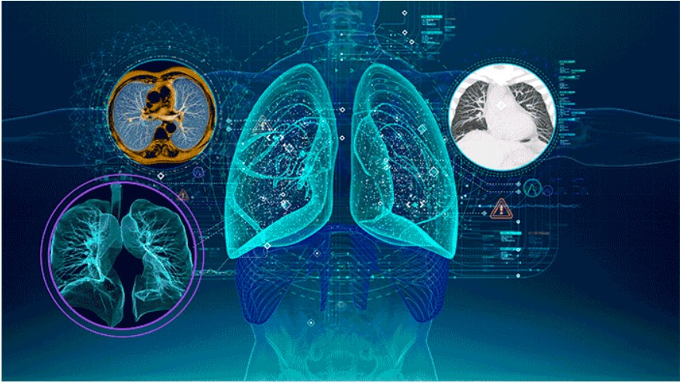
TITLE OF THE PROJECT
LUNG CANCER PREDICTION USING DEEP LEARNING

Slide 4
CHALLENGE STATEMENT
Cancer is a fatal illness often caused by genetic disorder aggregation and a variety of pathological changes. Cancerous cells are abnormal areas often growing in any part of human body that are life-threatening.
Cancer also known as tumor must be quickly and correctly detected in the initial stage to identify what might be beneficial for its cure.
Lung cancer is one of the dangerous and life taking disease in the world. However, early diagnosis and treatment can save life.
Lung cancer is one of the causes of cancer deaths. It is difficult to detect because it arises and shows symptoms in final stage.

Slide 5
CONCEPT AND SCOPE OF THE SOLUTION
Different types of cancer detection and classification using machine assistance have opened up a new research area for early detection of cancer.
This has shown the ability to reduce manual system impairments.
It presents several sections on state of art techniques, analysis and comparisons on benchmark datasets for the lung cancer detection.
The detection of lung cancer with general image processing techniques in CT scan data with good results and accuracy.
Image processing techniques are widely used in several medical areas for image improvement in earlier detection and treatment stages especially in various cancer tumours.

Slide 6
LITERATURE SURVEY
S.NO | TITLE | AUTHOR | NAME OF THE ORGANIZATION & YEAR | DESCRIPTION
1 | Feature extraction and LDA based classification of lung nodules in chest CT scan images | Aggarwal.T, Furqan.A, & Kalra.K. | International Conference On Advances In Computing, Communications And Informatics (ICACCI),August 2015. | This system has 84% accuracy, 97.14% sensitivity and 53.33% specificity. Although the system detects the cancer nodule, its accuracy is still unacceptable.
2 | Multi-crop convolutional neural networks for lung nodule malignancy suspiciousness classification’ | Shen W, Zhou M, Yang F, Yu D, Dong D, Yang C, | IEEE J Biomed Health Inform,2017. | Obtained a classification precision and 0.93%CUP scoring using the LIDC-IDRI data.

Slide 7
LITERATURE SURVEY
S.NO | TITLE | AUTHOR | NAME OF THE ORGANIZATION & YEAR | DESCRIPTION
3 | Prediction and Classification of Lung Cancer Using Machine Learning Techniques | Pragya Chaturvedi, Anuj Jhamb, Meet Vanani and Varsha Nemade | IOP Conference Series,2020. | Images of lungs for examination are captured by imaging techniques such as Positron Emission Tomography (PET), Magnetic resonance imaging (MRI) and X-ray.
4 | An Automatic Detection System of Lung Nodule Based on Multigroup Patch-Based Deep Learning Network | Jiang H, Ma H, Qian W, Gao M, Li Y, Hongyang J | IEEE J Biomed Health Inform 2018 | This CAD scheme can acquire the sensitivity of 80.06% with 4.7 false positives per scan and the sensitivity of 94% with 15.1 false positives per scan.

Slide 8
EXISTING METHOD
Multi-view Convolution network for model training.
Detection of the nodule by using 3-DCNN.
Methodology utilizing a simple incremental approach.
Lung nodules based on multi- patches cut out of the filters.
The Active Contour Model (ACM) process.

Slide 9
PROPOSED / INNOVATIVE METHOD
Image pre-processing, image erosion, median filtering, thresholds and feature extraction for image processing techniques to apply on CT images.
The first phase is we get CT scan image data.
The second phase, we implement image enhancement to improve quality of image.
The third phase is image segmentation which is an important step in the detection of cancer.
The fourth stage is feature extraction that is give us a conclusion whether there is a lung cancer or not.

Slide 10

TECHNOLOGY USED
Jupyter notebook

Slide 11
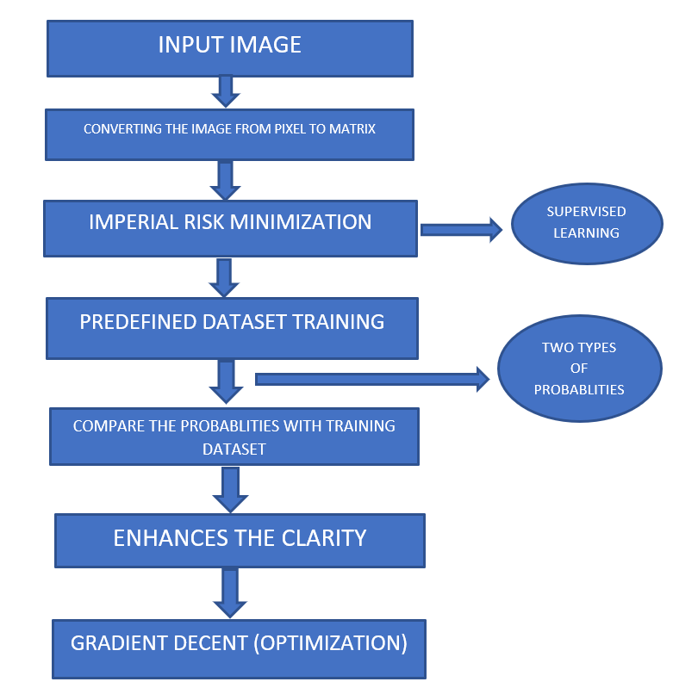
BLOCK DIAGRAM

Slide 12
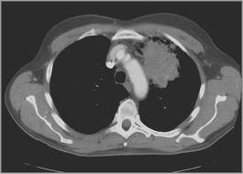
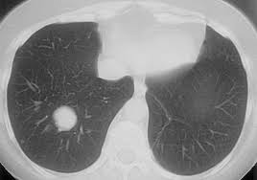
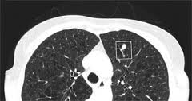
EXPERIMENTAL RESULTS
NORMAL

Slide 13
REFERENCES
Aggarwal.T, Furqan.A, & Kalra.K, ‘Feature extraction and LDA based classification of lung nodules in chest CT scan images’, International Conference On Advances In Computing, Communications And Informatics (ICACCI),August 2015.
Shen W, Zhou M, Yang F, Yu D, Dong D, Yang C, et al. ‘Multi-crop convolutional neural networks for lung nodule malignancy suspiciousness classification’. Pattern Recognition 2017;61:663–73
Jiang H, Ma H, Qian W, Gao M, Li Y, Hongyang J, ‘An Automatic Detection System of Lung Nodule Based on Multigroup Patch-Based Deep Learning Network’. IEEE J Biomed Health Inform 2018.
Pragya Chaturvedi, Anuj Jhamb, Meet Vanani and Varsha Nemade,’ Prediction and Classification of Lung Cancer Using Machine Learning Techniques, IOP Conference Series,2020.

Slide 14
CONTEST PARTICIPATION
Techgium contest by L&T 2021.

Slide 15
THANK YOU

